Slide 1

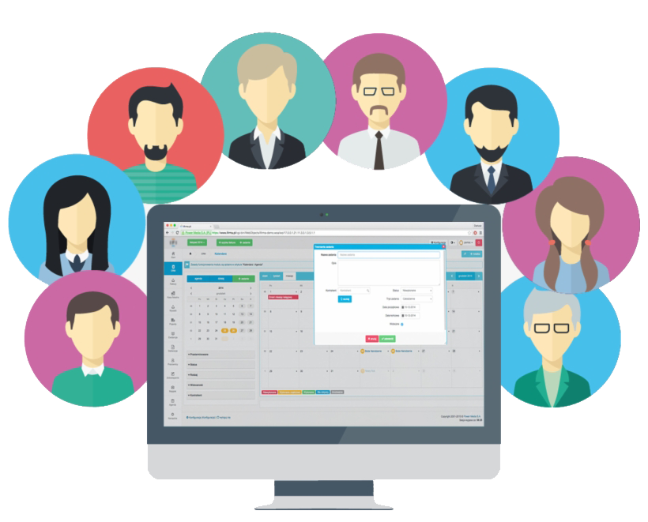


Name: Filopateer Fouad Bekheet
Instructor: Eng/ Mohamed Shoshan
Course: Flutter (WE course)
Project: system of a company

Slide 2
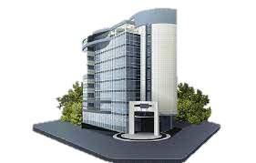
Target of the application:
Make a comfortable application for a commercial company deals with employees and clients.
Main classes:
Login class
IT class
Employee class

Slide 3

Login class:
First page: it is the first page of the app that starts with welcome screen and then the user will choose his job which is IT or employee or client or visual history.
Second page: if he chooses IT, he will go to IT’s login page.
Third page: if he chooses employee, he will go to employee’s login page.
Fourth page: if he chooses client, he will go to
client’s login page.
Last page: if he chooses visual history, he will skip the login

Slide 4
IT class:
Mainly it is the biggest class in the project and mainly it covers most of half the project idea.
it contains add and delete every user(employee-client).
It contains My account to edit personal data
Only super admin that can add or delete admins
admins only have sign up.
it holds all the requirements of the support part in the project.
It holds all the tasks and deals for clients and employees.
It add and delete the deals for clients and add and remove tasks for employees
it contains messaging and contacts with the client and employees if the company wants to respond to the client or the leader want to send a message to the employee.
It also contains the financial part which only the super admin can edit on salary or bonus of any admin or employee

Slide 5

Employee class:
it contains My account page which contains all the information that if the employee wants to update on it.
it contains the incoming tasks for his job.
it contains support to talk with IT.
It contains his salary and bonus
It contains offers the company provides it to its employee.
it contains messaging with the clients.
it also messaging box to receive messaging
from IT.

Slide 6

Client class:
It doesn’t have a lot of abilities in the application except few things:
next projects and deals between client’s company and our company.
messaging box to receive messages from employee or IT.
messaging to send a message to IT or employee.

Slide 7

Database :
I will use two tables for storage the data.
First table will hold all the information for IT and employee.
Second table will hold all the information for clients.

